Slide 1

Amazon Sales Data Analysis
Key Insights and KPI’s
Presenter Name: Shravani Tamanna

Slide 2
Brief Overview of the Main Findings and Insights:
Overall Performance:
Total revenue: $137.35 million
Total profit: $ 44.17 million
Top Performing Regions:
Europe and Asia lead in revenue and profit.
High sales in Cosmetics and Office Supplies.
High-Profit Item Types:
Top items: Cosmetics, Office Supplies, Baby Food.
Sales Channels:
Online sales outperform offline sales.
Impact of Order Priority:
High-priority orders drive significant revenue and profit.
Monthly Trends:
Peak sales in specific months indicate seasonal trends.
Top Countries:
Leading countries by revenue: Honduras, Myanmar, Djibout, Turkmenistan and Mexico.
Profit Margin and Average Order Value:
Profit margin: 32.16%
Average order value: $1.37 million

Slide 3
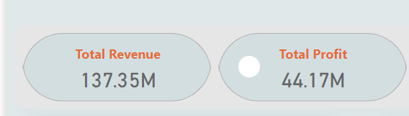
Total Revenue & Profit
Key Insights:
Total Revenue: $137.35M
Total Profit: $44.17M

Slide 4
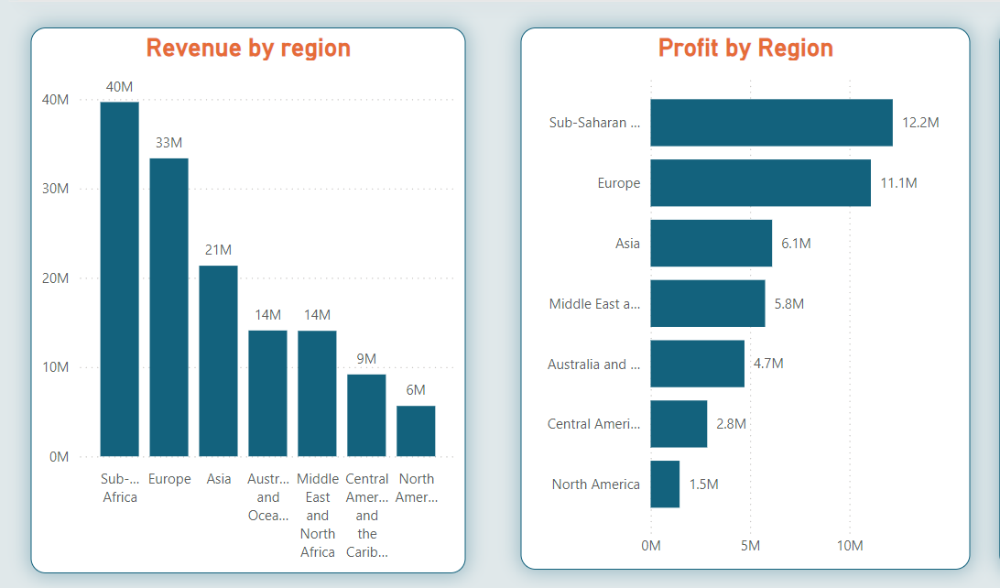
Revenue and Profit by Region
Key Insights:
Most Profitable Region: Europe
Least Profitable Region: North America

Slide 5
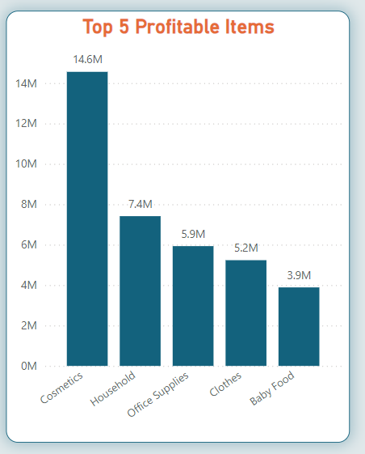
Top 5 Most Profitable Item Types
Key Insights:
Top Item Type: Cosmetics
Profit: $14.6M

Slide 6
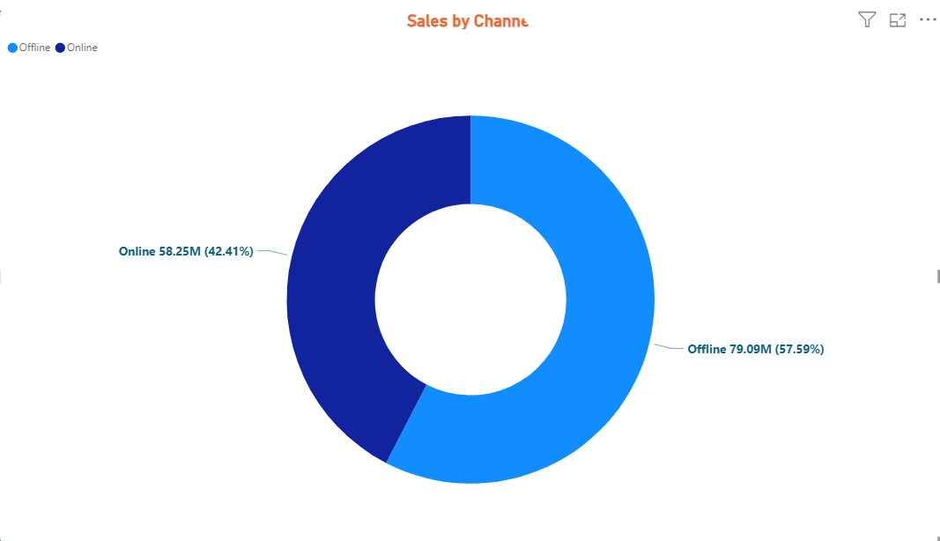
Sales by Channel
Key Insights:
Online Sales: $58253959.11
Offline Sales: $79094809.20

Slide 7
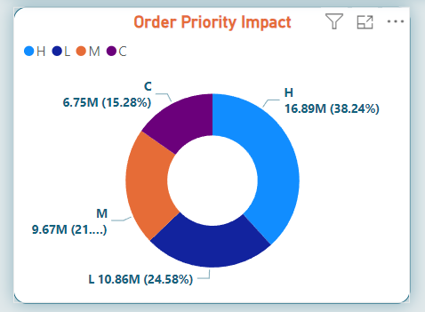
Order Priority Impact
Key Insights:
High Priority Orders: H – 38.24%
Low Priority Orders: C -15.28%

Slide 8
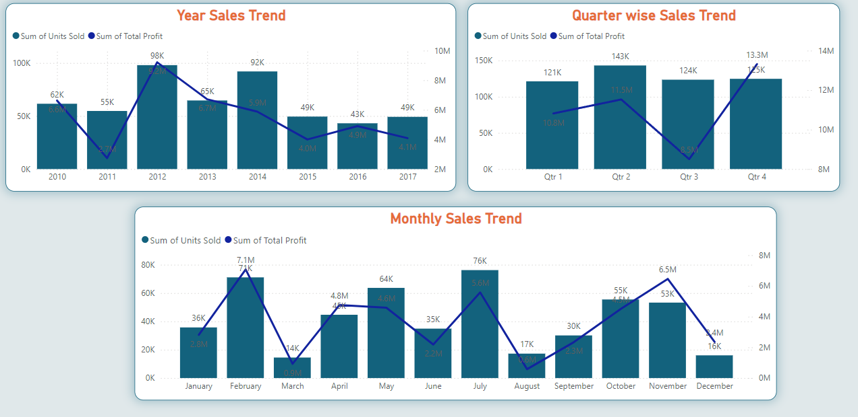
Monthly Sales Trend
Key Insights:
Month: FEB – $25M (All years), 2016 – November – $5.9M
Lowest Sales Month: Aug – $5876.41K (All years), 2016 –March– $197.88K

Slide 9
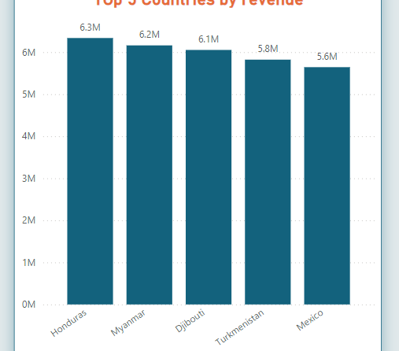
Top 5 Countries by Revenue
Key Insights:
Top Country: Honduras
Revenue: $6.3M

Slide 10
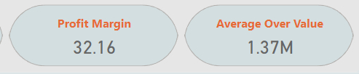
Profit Margin and Average Order Value
Key Insights:
Profit Margin: 32.16%
Average Order Value: $1.37M

Slide 11
Conclusion and Recommendations
Significant Achievements:
Strong online sales performance.
High profitability in key item categories.
Market strength in Europe and Asia.
Efficient order prioritization.
Areas Needing Attention:
Boost sales in underperforming regions.
Increase marketing efforts during non-peak months.
Strategies to increase average order value.
Enhance inventory management to prioritize high-demand and high-profit item types.
Leverage seasonal trends to maximize sales during peak periods.
Expand market presence in top-performing countries to sustain revenue growth.

Slide 12
Thank you
Shravani Tamanna
7276653664
shravani.tamanna@gmail.com

